Slide 1


How to log into Microsoft Teams to find your assignments
A pupils guide

Slide 2
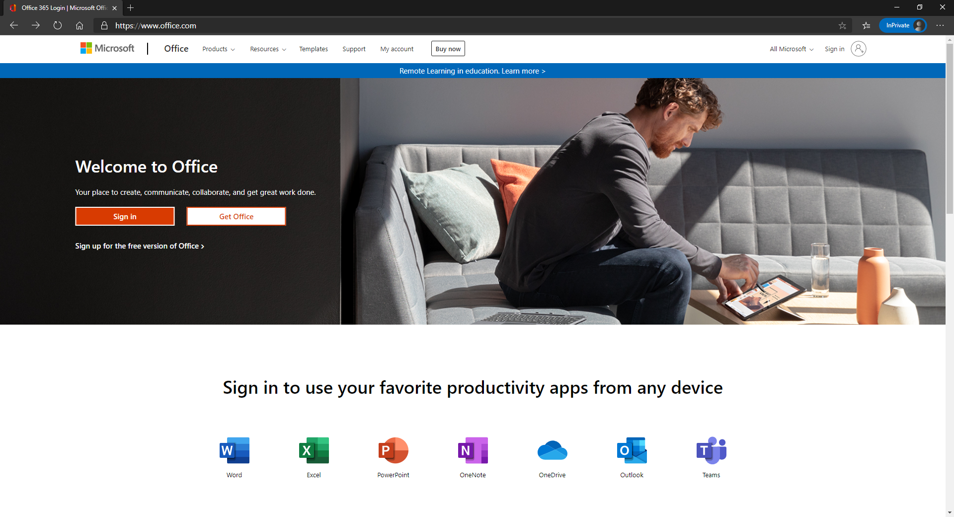
To access your Teams pages and assignments you need to firstly go to www.office.com and sign in

Slide 3
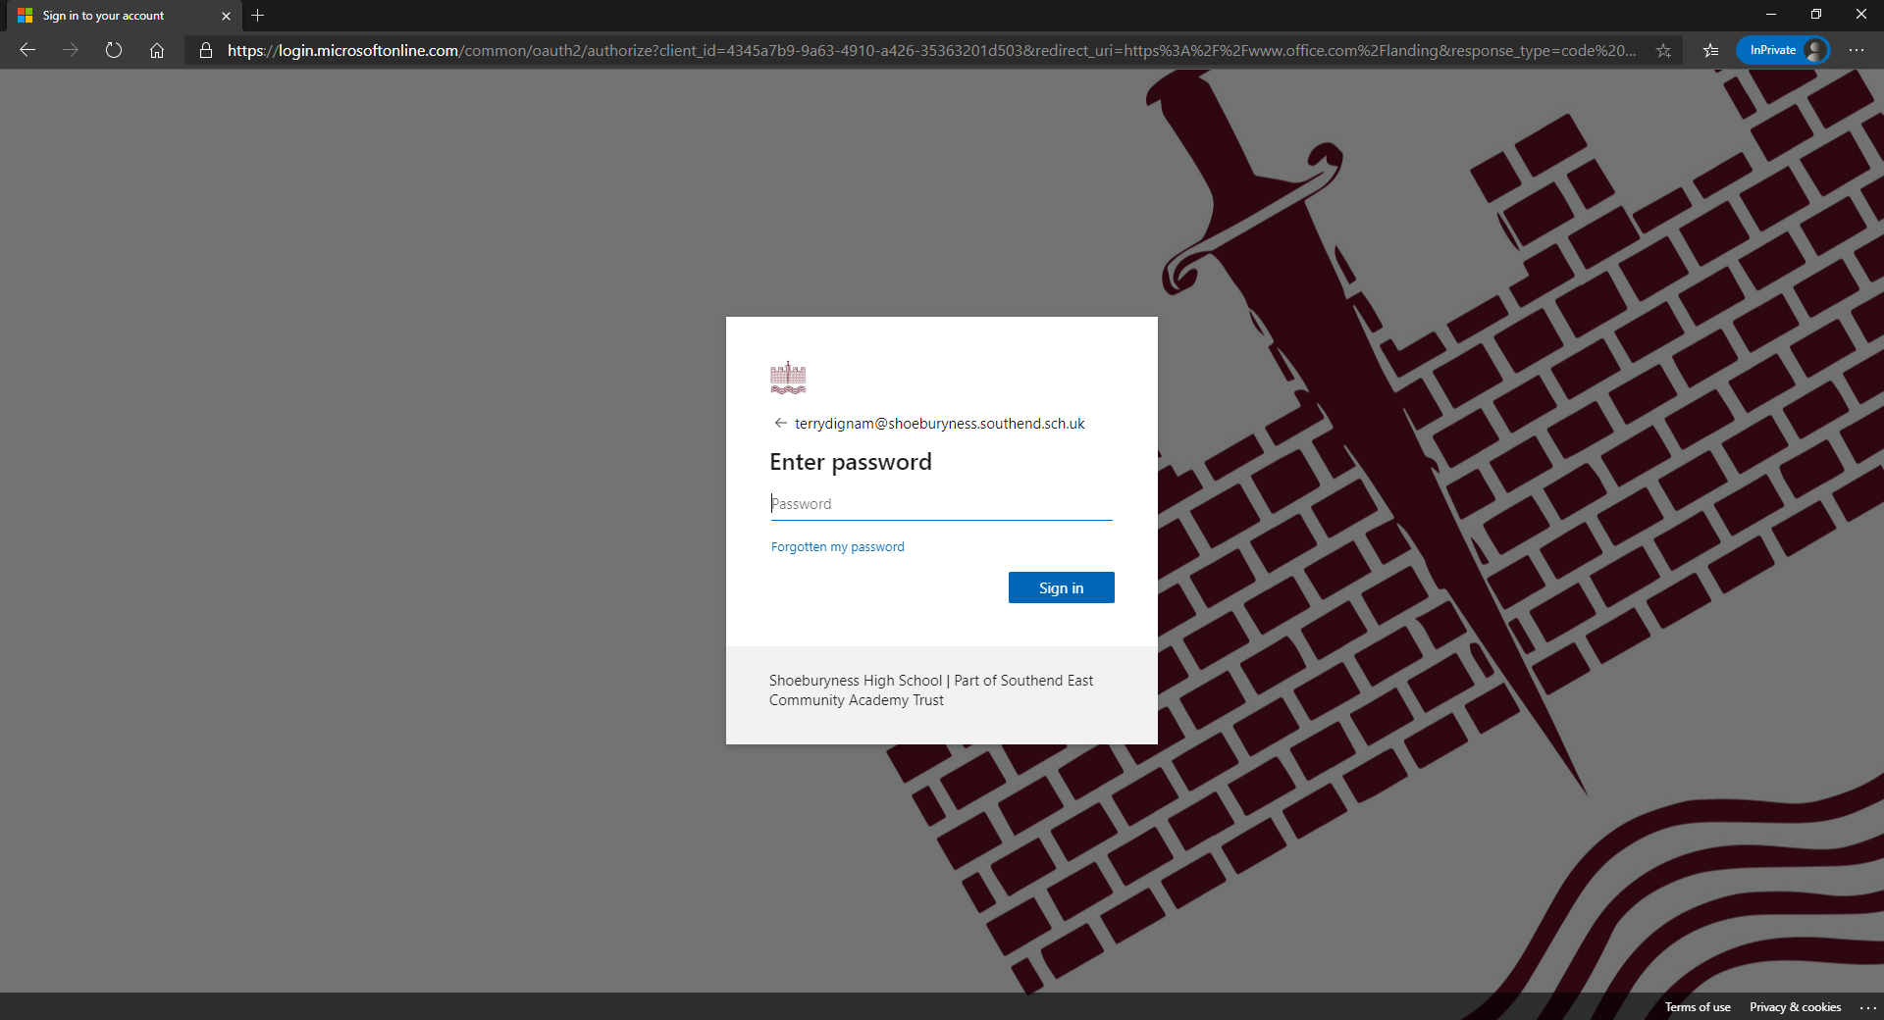
Sign in using School email and password – this would be your normal way of logging into any PC on school site

Slide 4
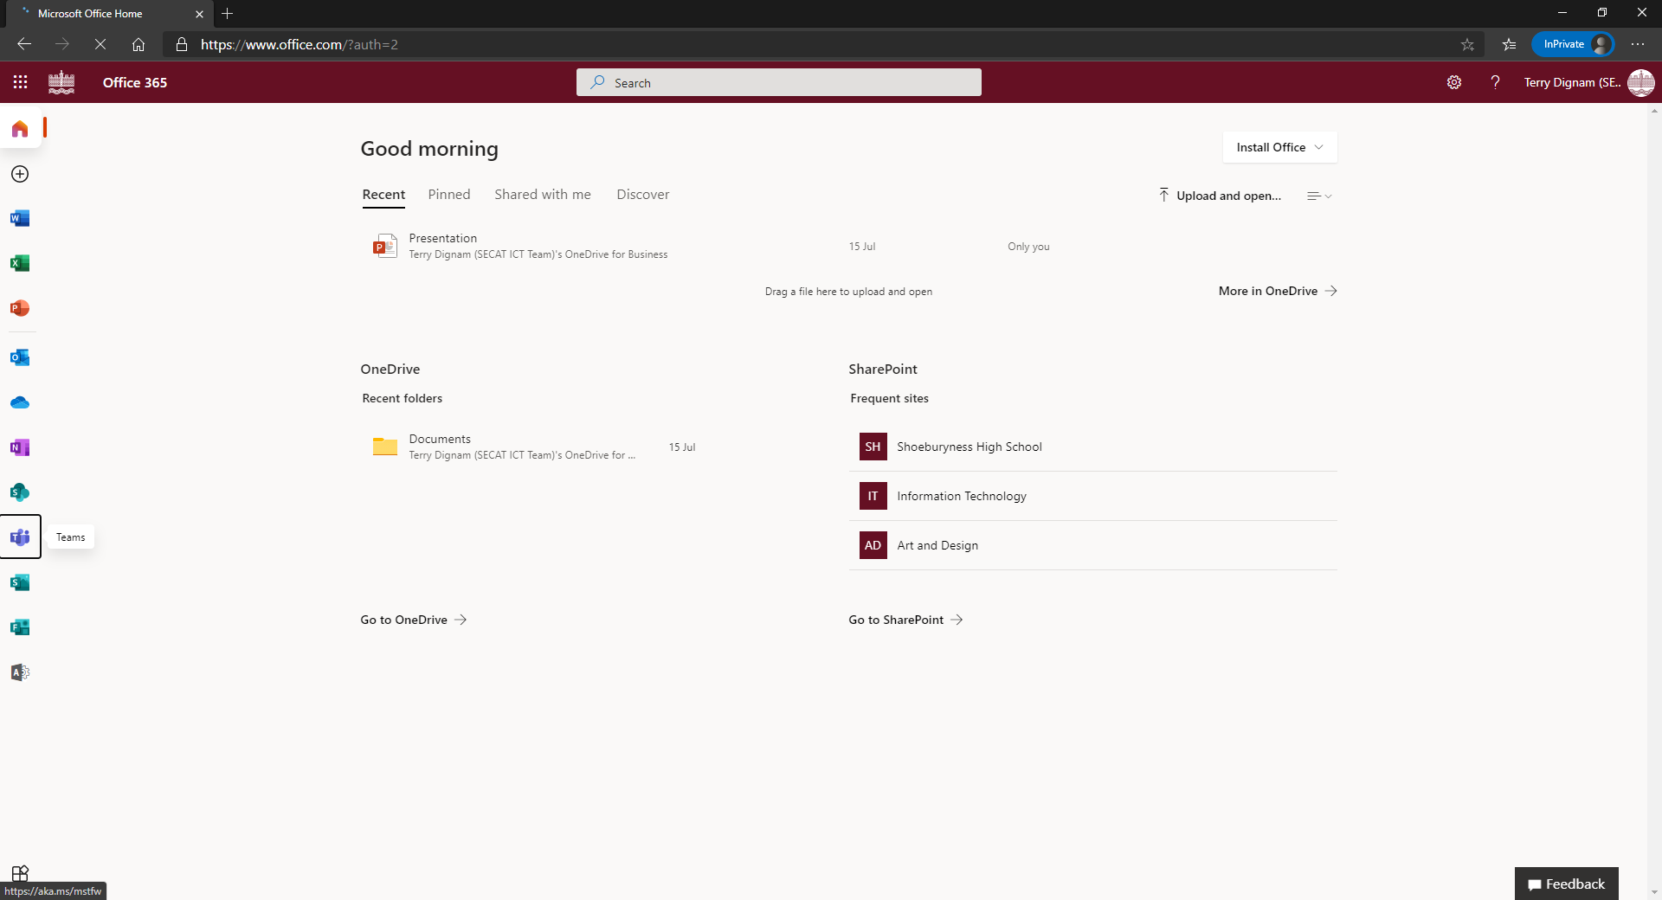
Go to TEAMS on the left menu bar and click on it

Slide 5
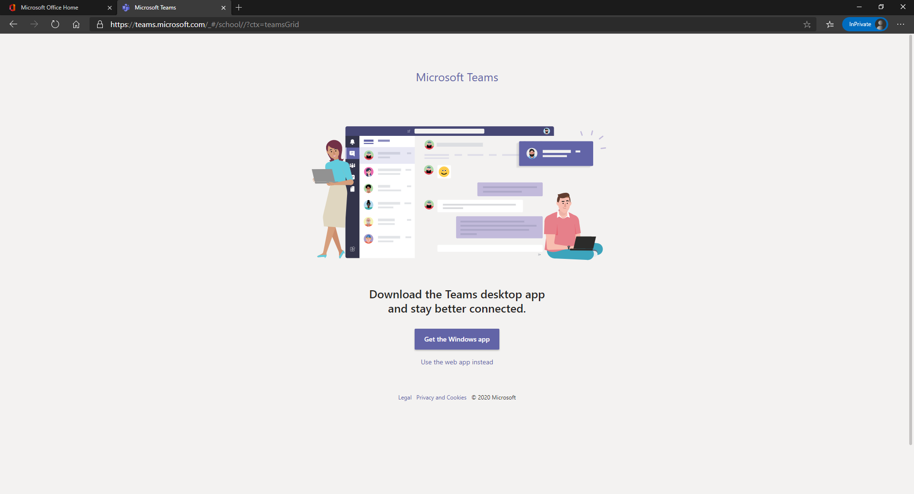
Or if off site or using a phone…..Select Use the web app instead

Slide 6
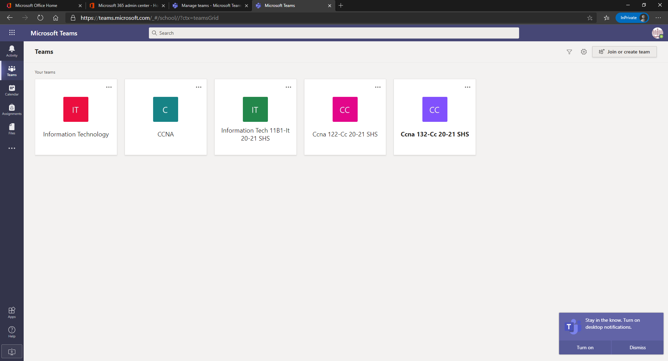
Click on the class icon for the class you wish to find an assignment from.

Slide 7
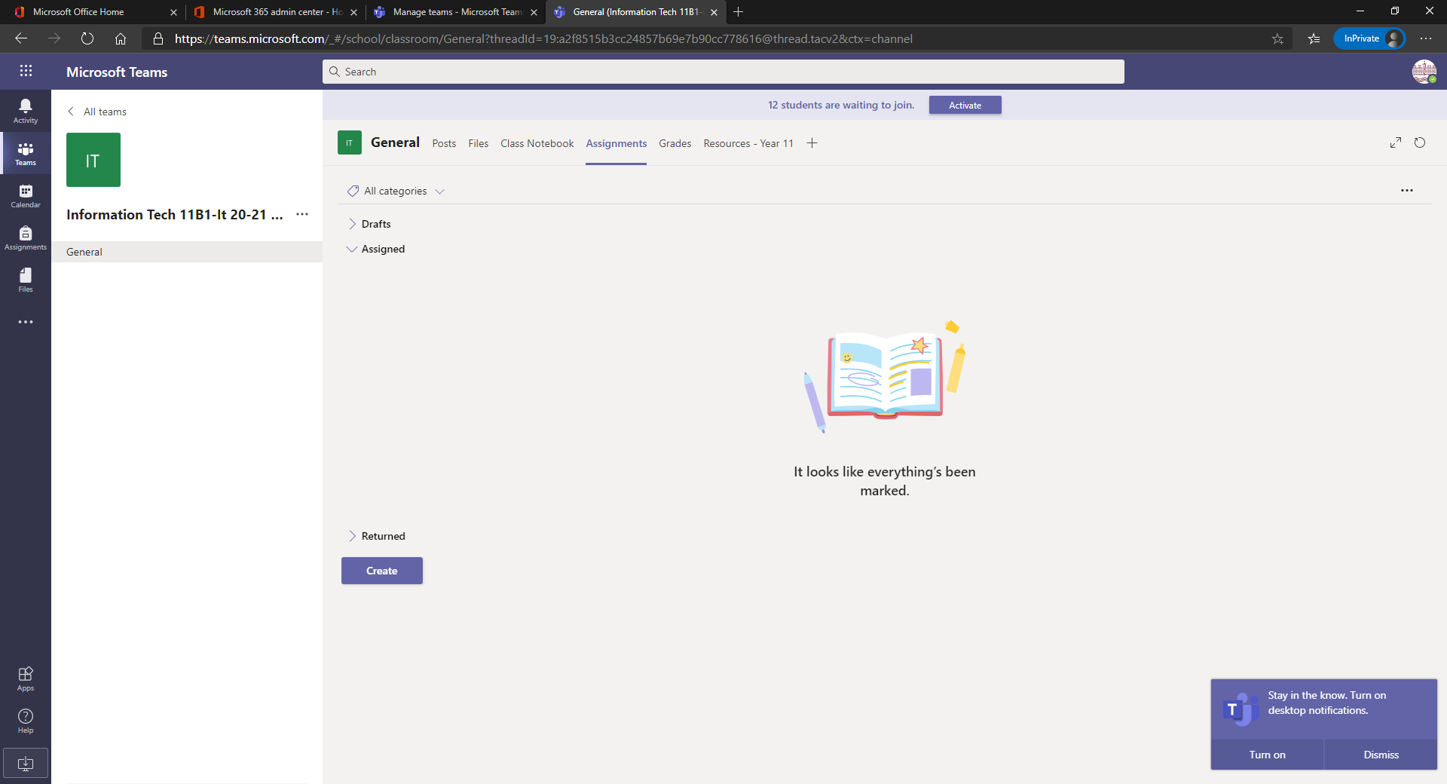
Click Assignments from the tabs and select the assignment that you wish to access

Slide 8
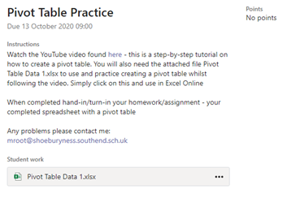
Once you click on the assignment it will look something like this…..

Slide 9
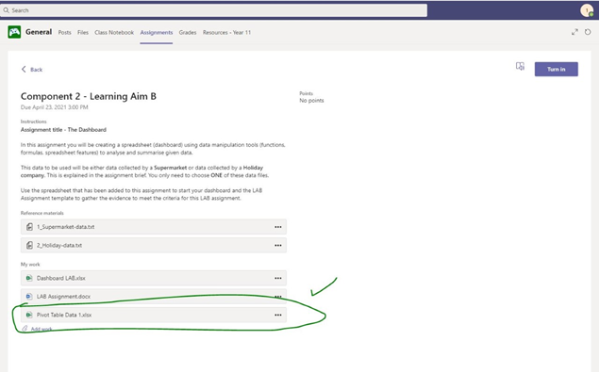
To hand in your work – click the “Turn In” button in blue on the right hand of the screen

